Slide 1

ECA0908 DIGITAL SIGNAL PROCESSING
A Burg spectral estimation algorithm uses model order 2 instead of 10, producing poor spectral peaks. Identify the implementation error.
SEP 2026
Presented By:
Laxmi ManiKanta-192312651
Supervison of:
Dr.Y.MARY REEJA

Slide 2
INTRODUCTION
Burg spectral estimation is a parametric method used to estimate the Power Spectral Density (PSD) of a signal.
It models the signal using an Autoregressive (AR) model.
If the model order is too low (e.g., 2 instead of 10), the algorithm underfits the signal.
This results in poor spectral resolution, broader peaks, and loss of important frequency components.

Slide 3
CODE
% Incorrect Implementation
p = 2;
[Pxx,f] = pburg(x,p,512,Fs);
% Correct Implementation
p = 10;
[Pxx,f] = pburg(x,p,512,Fs);
plot(f,10*log10(Pxx));
xlabel('Frequency (Hz)');
ylabel('Power/Frequency (dB/Hz)');
title('Burg Power Spectral Density Estimate');
grid on;

Slide 4
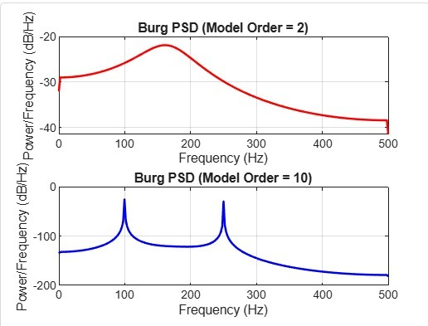
OUTPUT

Slide 5
THANK YOU

